Slide 1

Lecture
on
“Advanced Computer Architecture –TCS 704”
by
Akansha Gupta
DEPARTMENT OF COMPUTER SCIENCE AND ENGINEERING
GRAPHIC ERA DEEMED TO BE UNIVERSITY – 248002

Slide 2
Cache optimization

Slide 3
Improving Cache Performance How?
Reduce Miss Rate
Reduce Cache Miss Penalty
Reduce Cache Hit Time

Slide 4
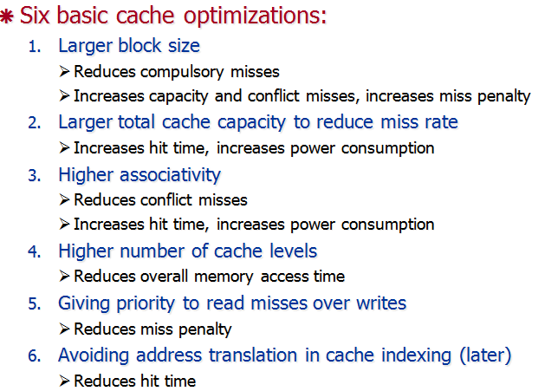
Six Basic Cache Optimizations

Slide 5
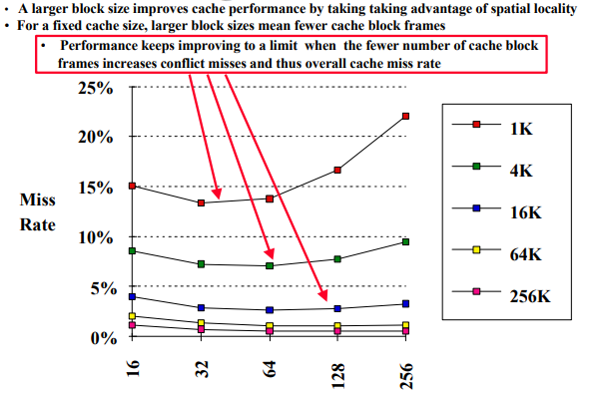
1.Larger block size

Slide 6
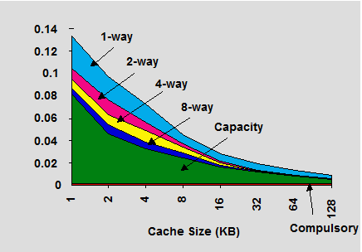
2. Reduce Misses by Increasing Cache Size
Increasing cache size reduces cache misses
both capacity misses and conflict misses reduced

Slide 7
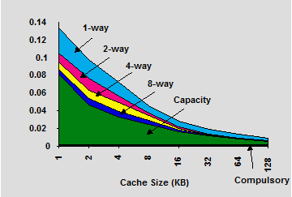
3. Reduce Misses via Higher Associativity
2:1 Cache Rule
Miss Rate DM cache size N ≈ Miss Rate FA cache size N/2
Not merely empirical
Theoretical justification in Sleator and Tarjan, “Amortized efficiency of list update and paging rules”, CACM, 28(2):202-208,1985
Beware: Execution time is only final measure!
Will clock cycle time increase?
Hill [1988] suggested hit time ~10% higher for 2-way vs. 1-way

Slide 8
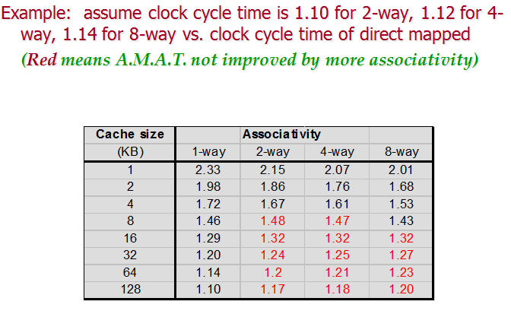
Example: Ave Mem Access Time vs. Miss Rate

Slide 9
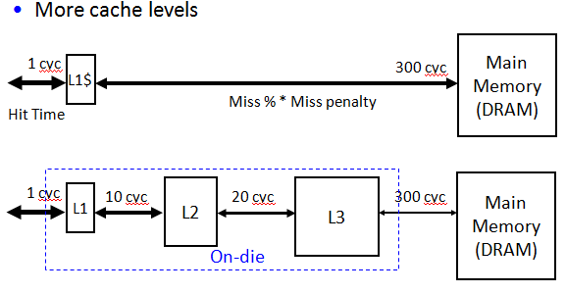
4. Higher Number of Cache Levels

Slide 10
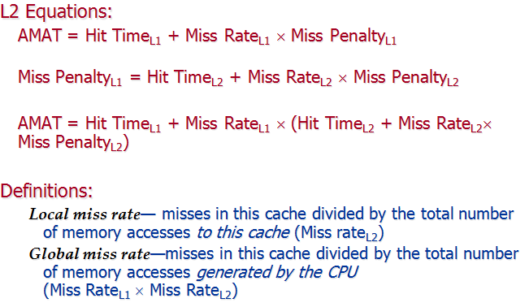

Slide 11
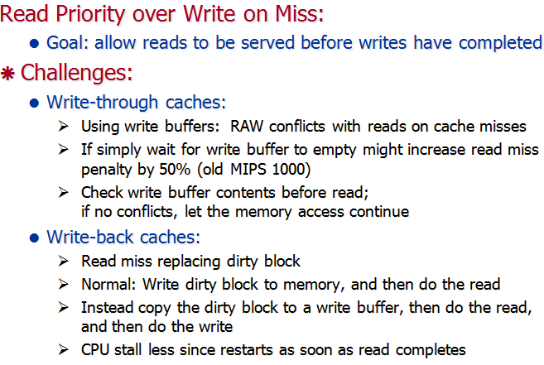
5. Reducing Miss Penalty

Slide 12
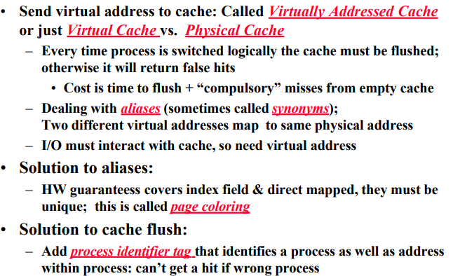
6.Avoiding Address Translation in Cache Indexing

Slide 13
https://youtu.be/CK0bMO_JX6Y
THANKS

